Slide 1
National Schools Twenty20 competition
Finals day July 2014
Arundel Castle

Slide 2
Photographs
by
Patrick Eagar
© No images may be reproduced without permission

Slide 3
The first semi-final
Woodhouse Grove in mauve
Tonbridge in red

Slide 4
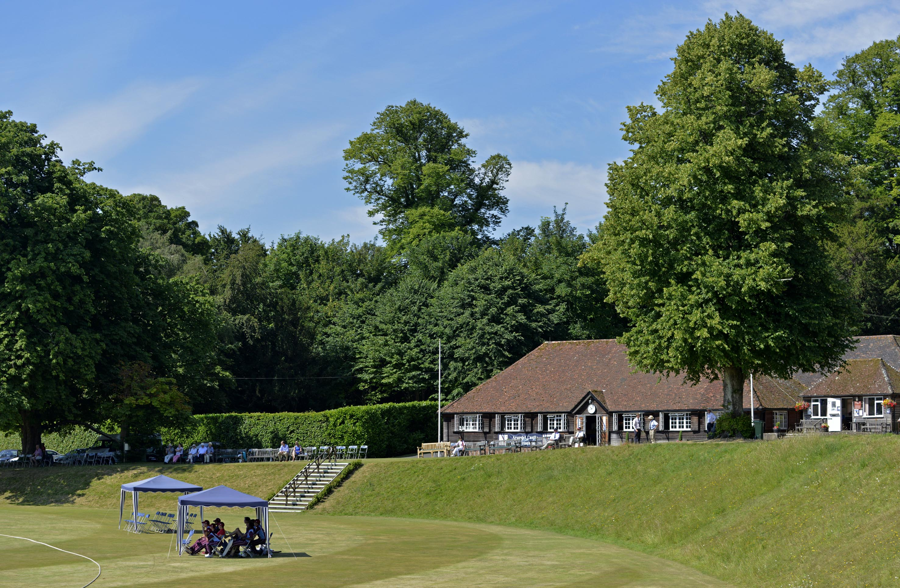
Finals Day, National Schools Twenty20 Competition ARUNDEL, SUSSEX - JULY 2014. View of Arundel Castle cricket ground

Slide 5
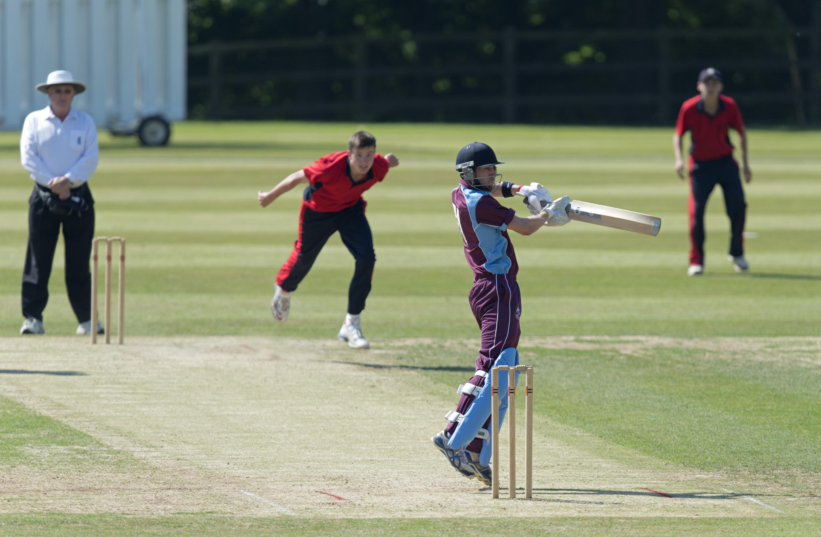
Woodhouse Grove v Tonbridge. Dylan Budge batting during his 61

Slide 6
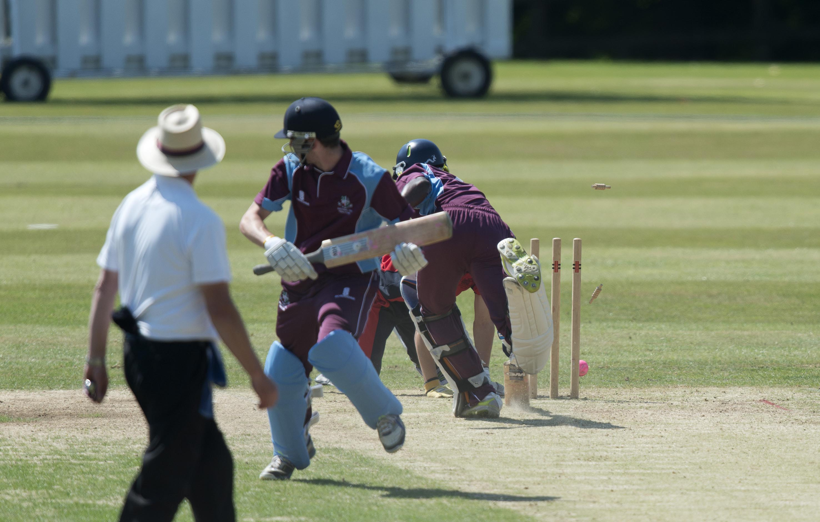
M Edward run out (Monkhouse)

Slide 7
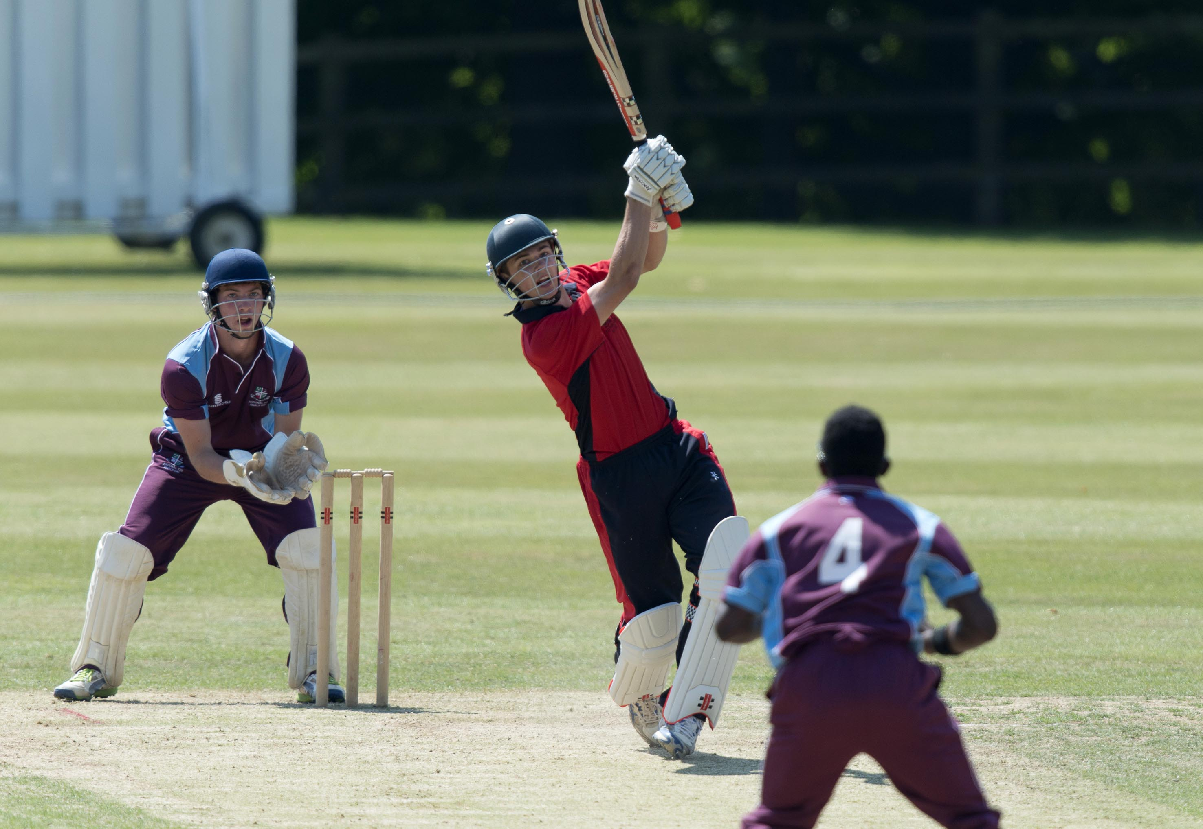
M O'Riordan drives L M Edward during his 32

Slide 8
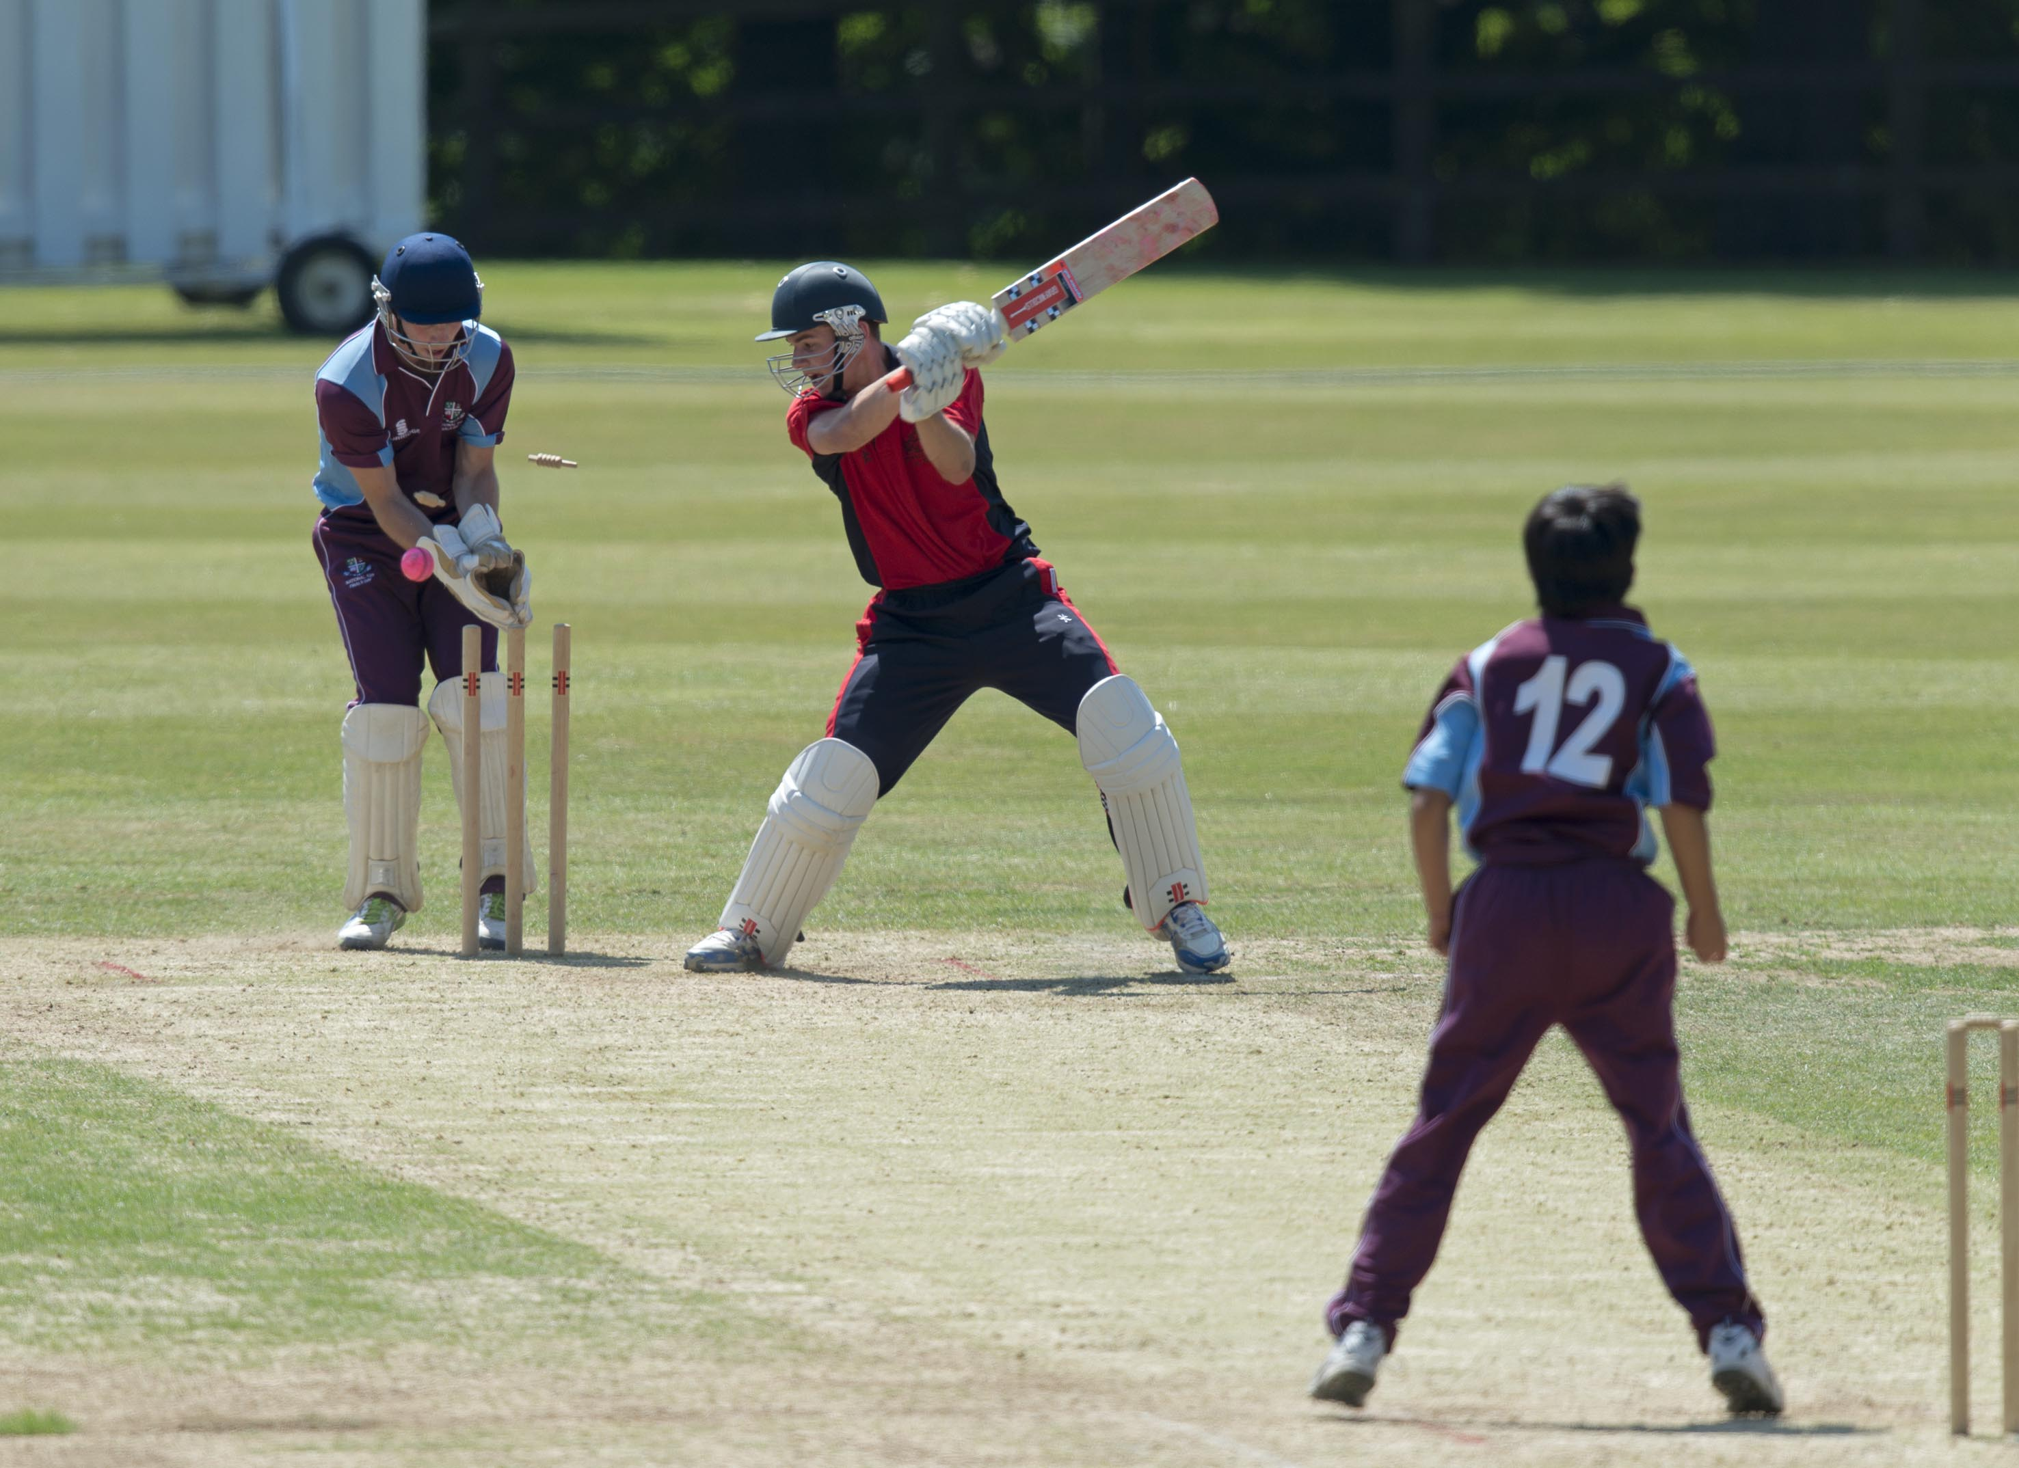
M O'Riordan bowled by A Ahmed for 32

Slide 9
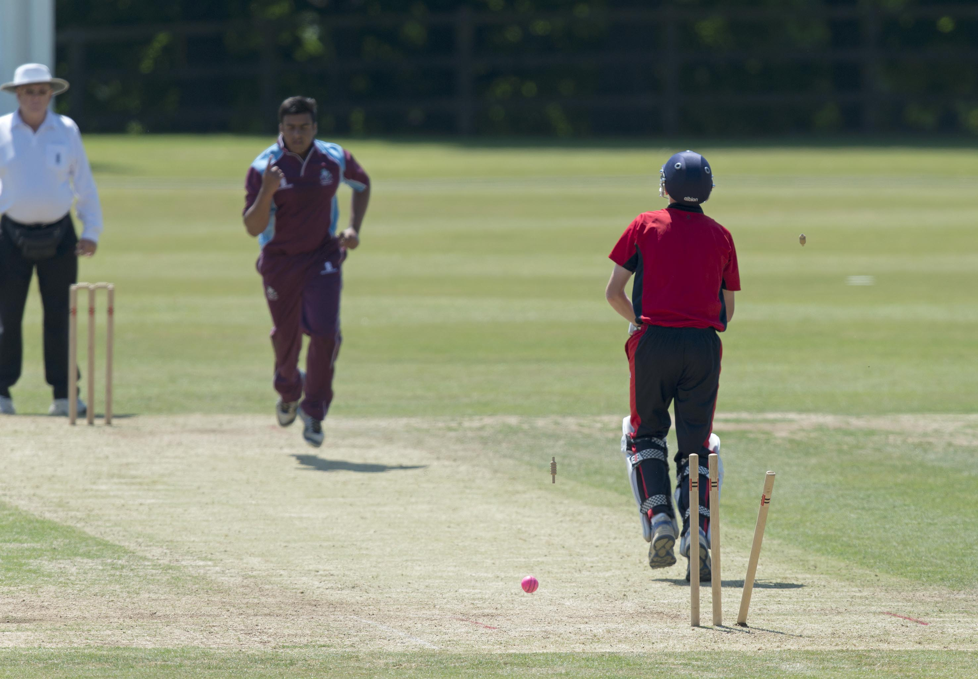
Crawley bowled by J Malik for 12

Slide 10
The second semi-final
Millfield in red
Bedford in blue

Slide 11
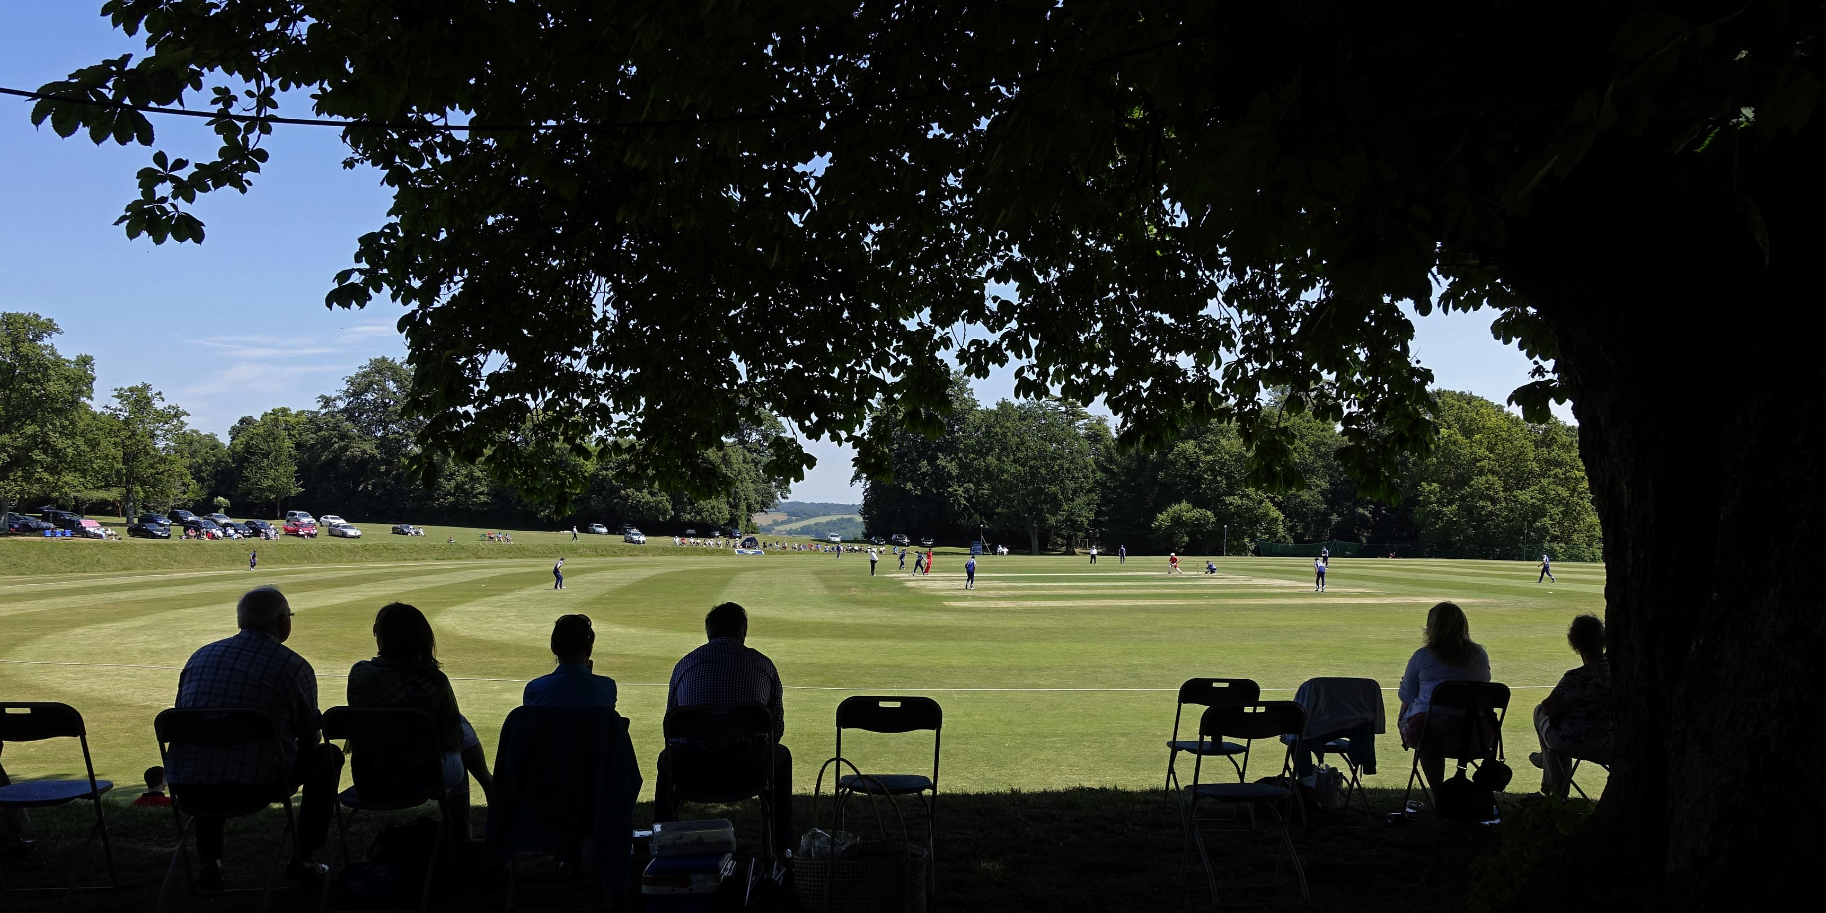
Millfield v Bedford. A view of the Arundel Castle Cricket Ground

Slide 12
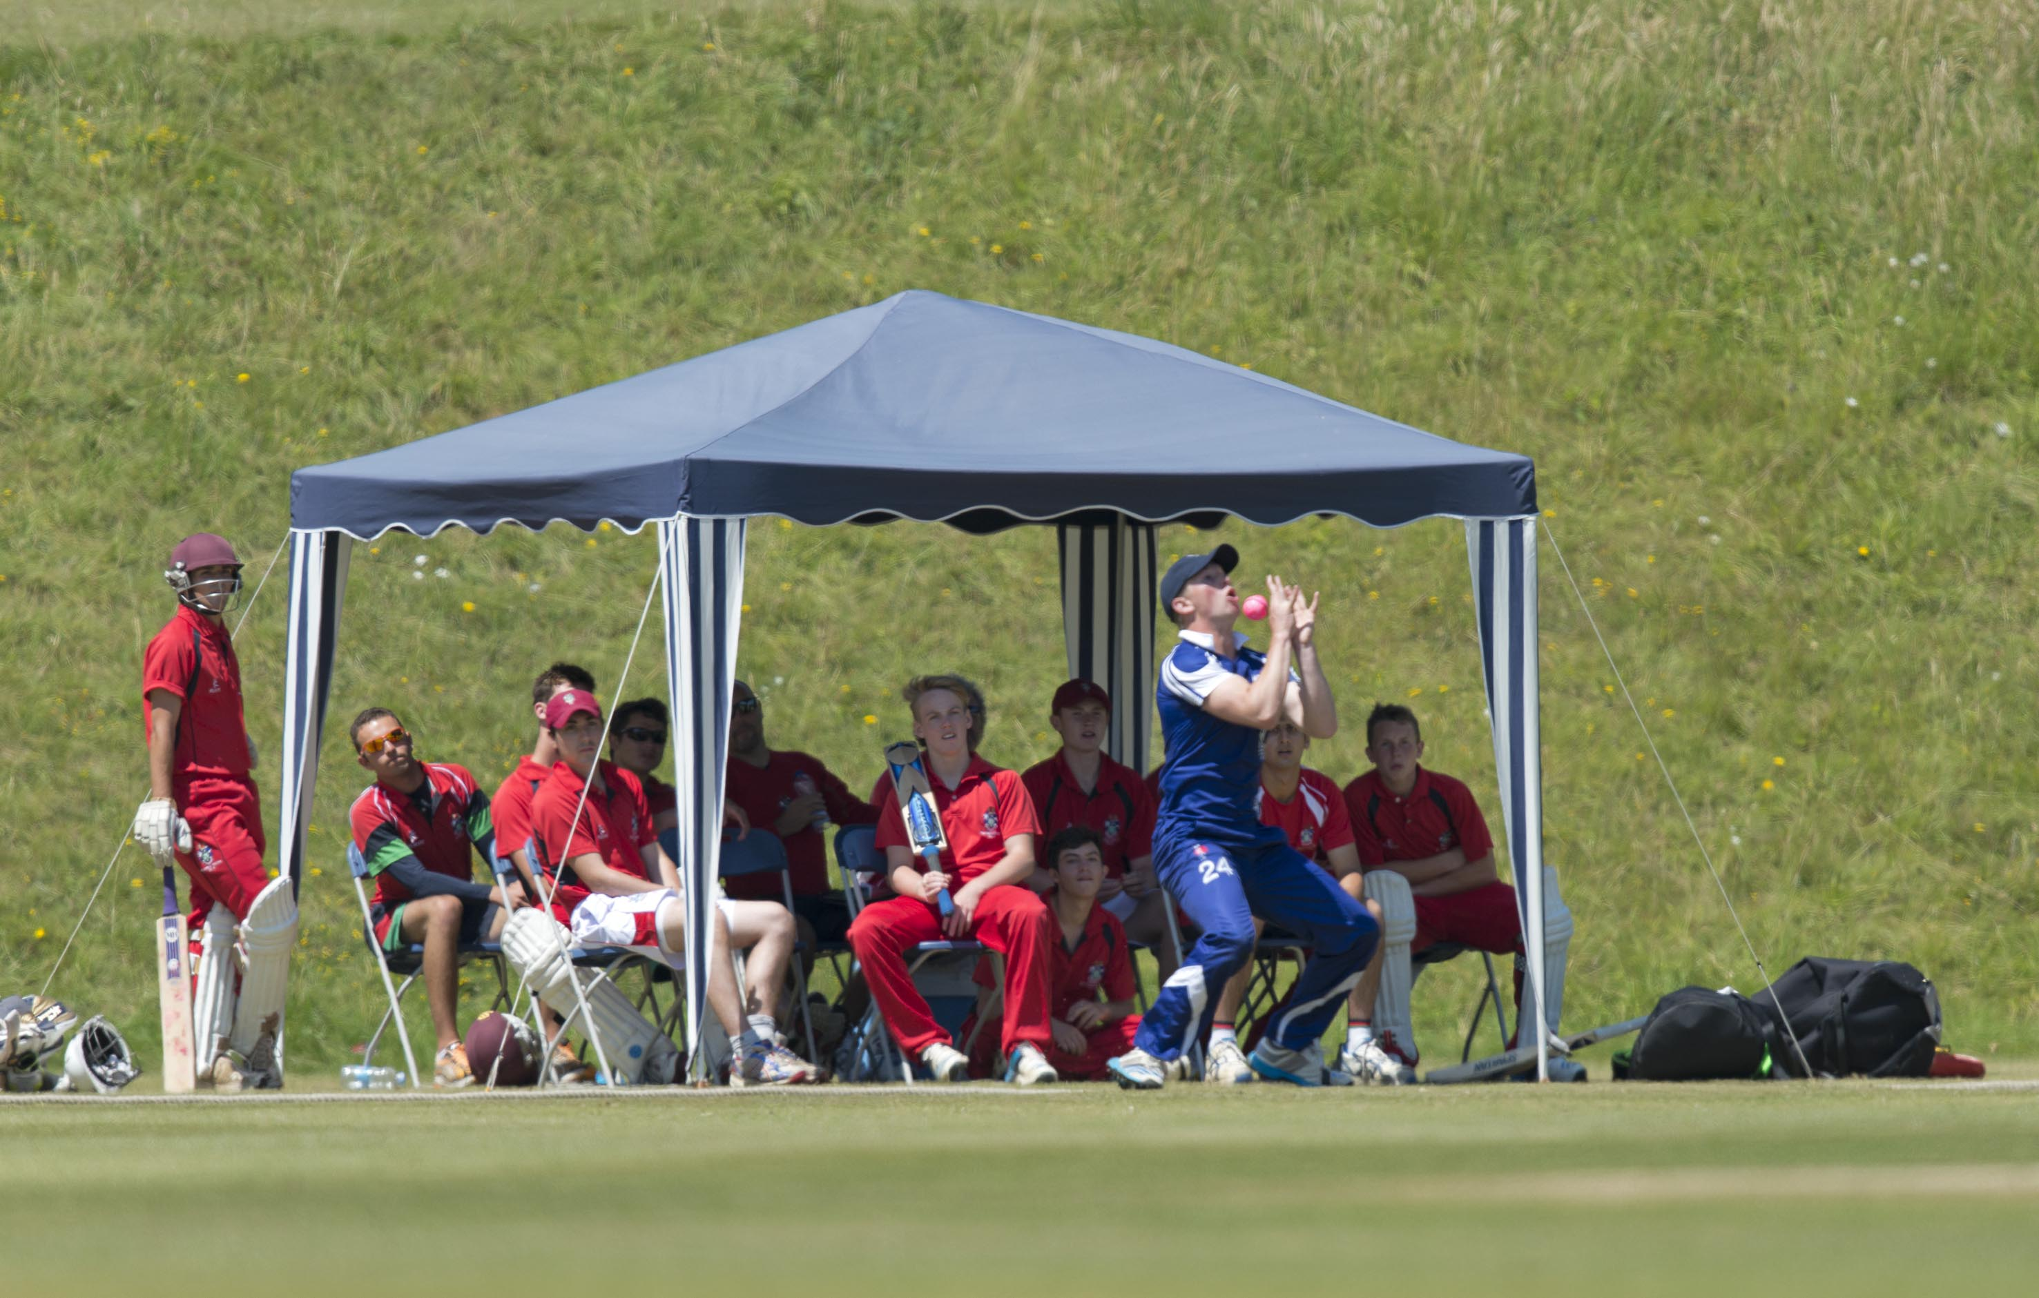
A Axon drops a catch watched by the Millfield team

Slide 13
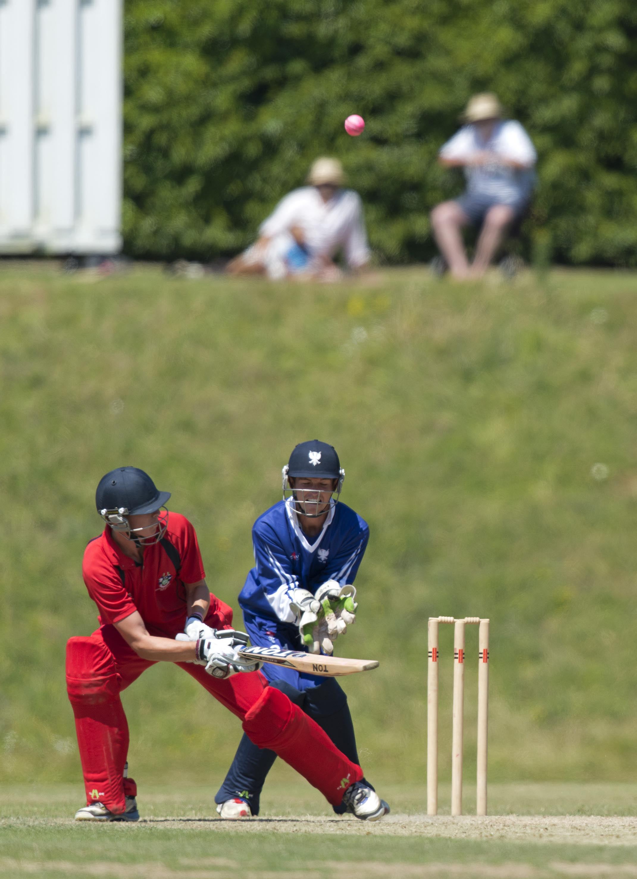
G T Hankins who made 69 not out for Millfield

Slide 14
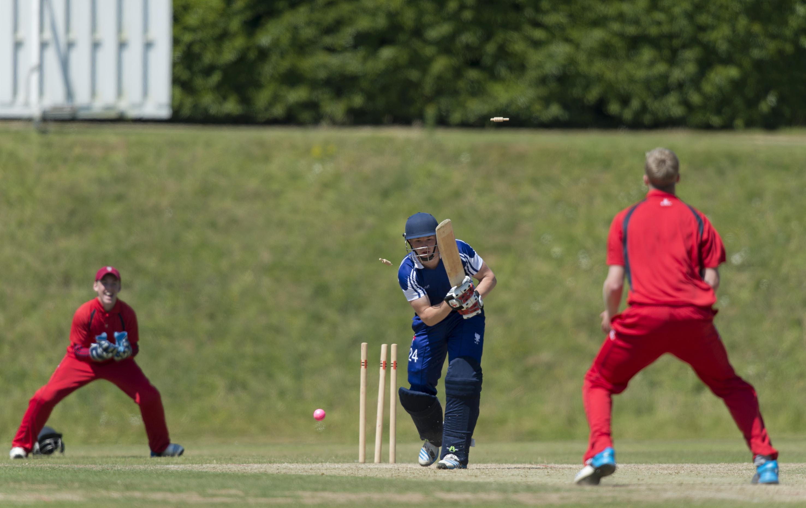
A Axon bowled by B D Fullard for 11

Slide 15
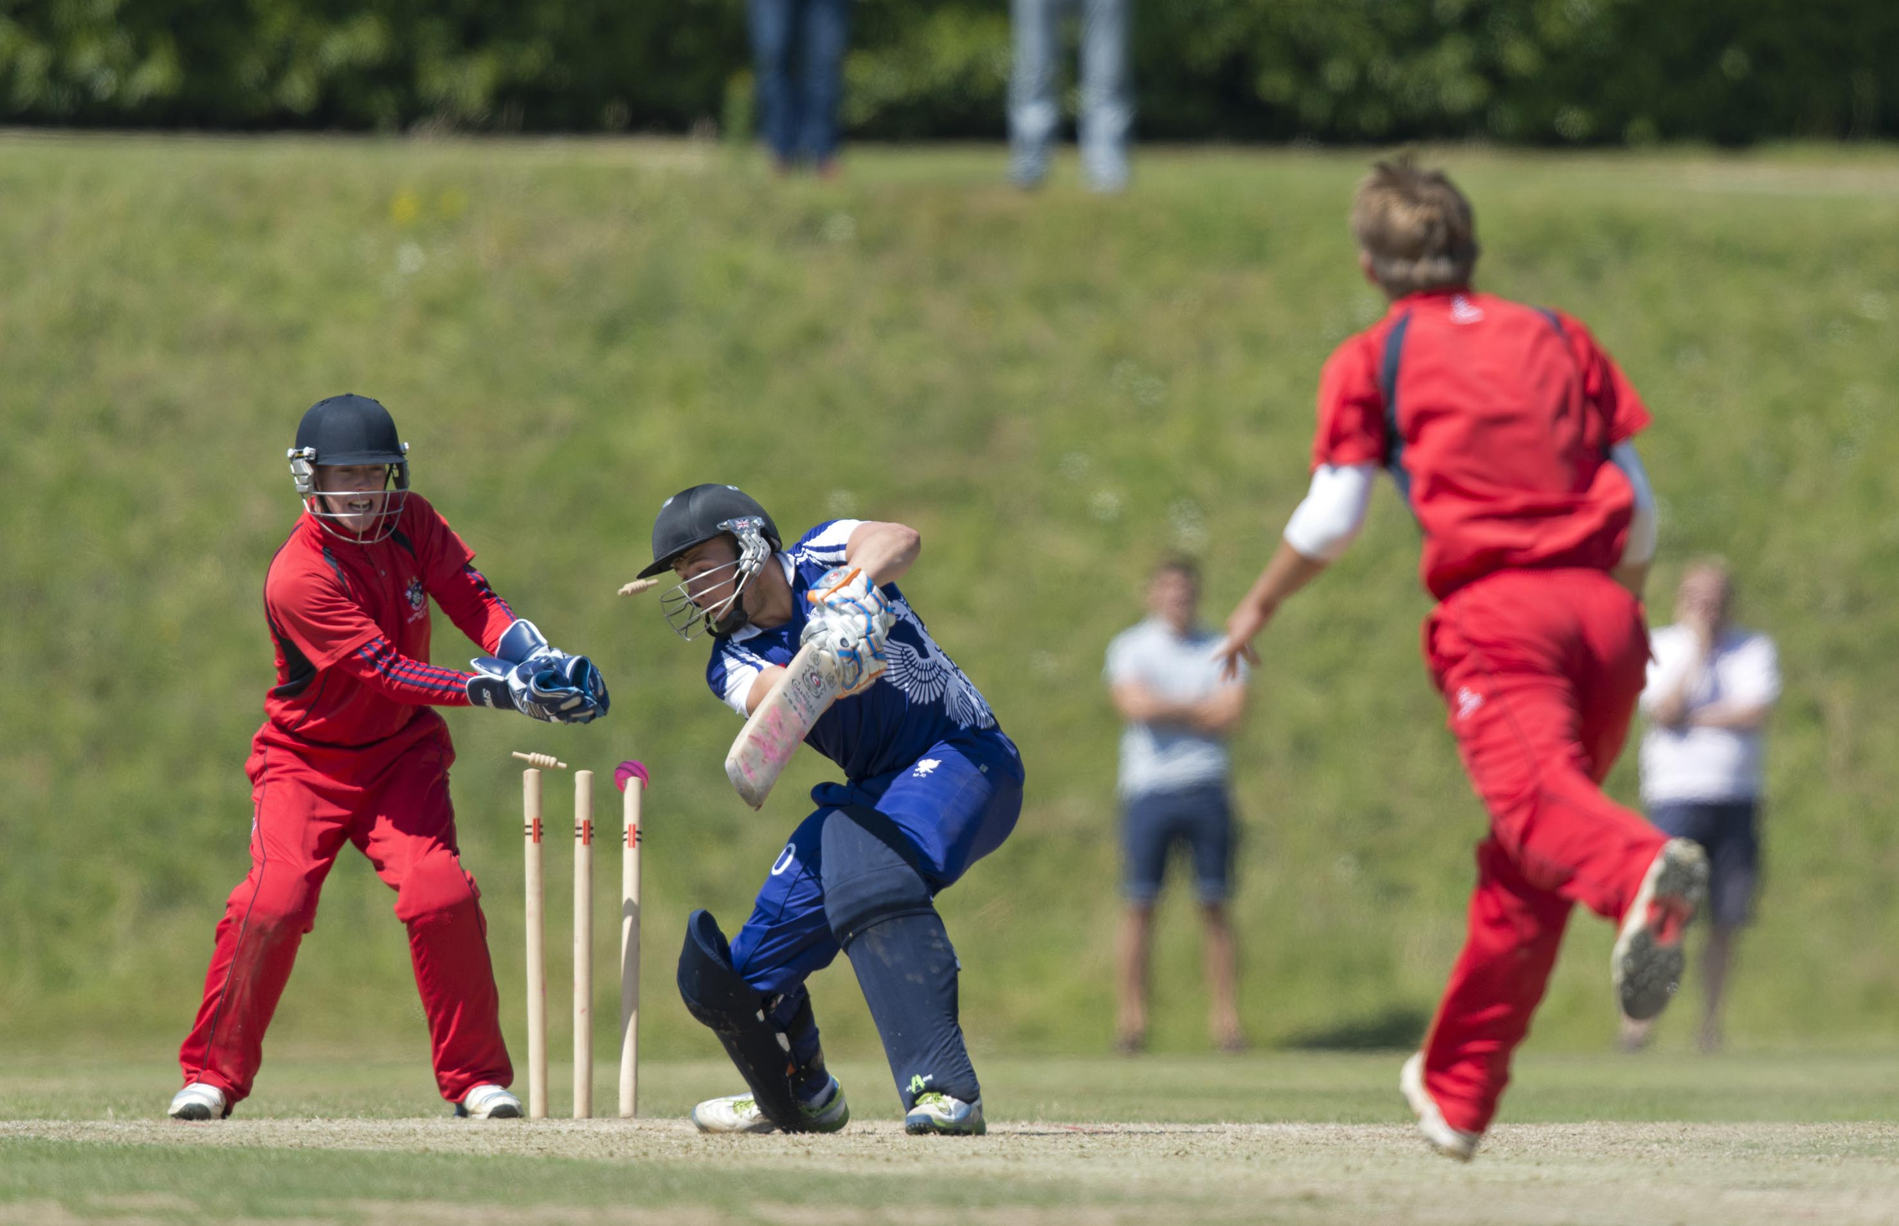
C O Thurston bowled by J O Symes for 38

Slide 16
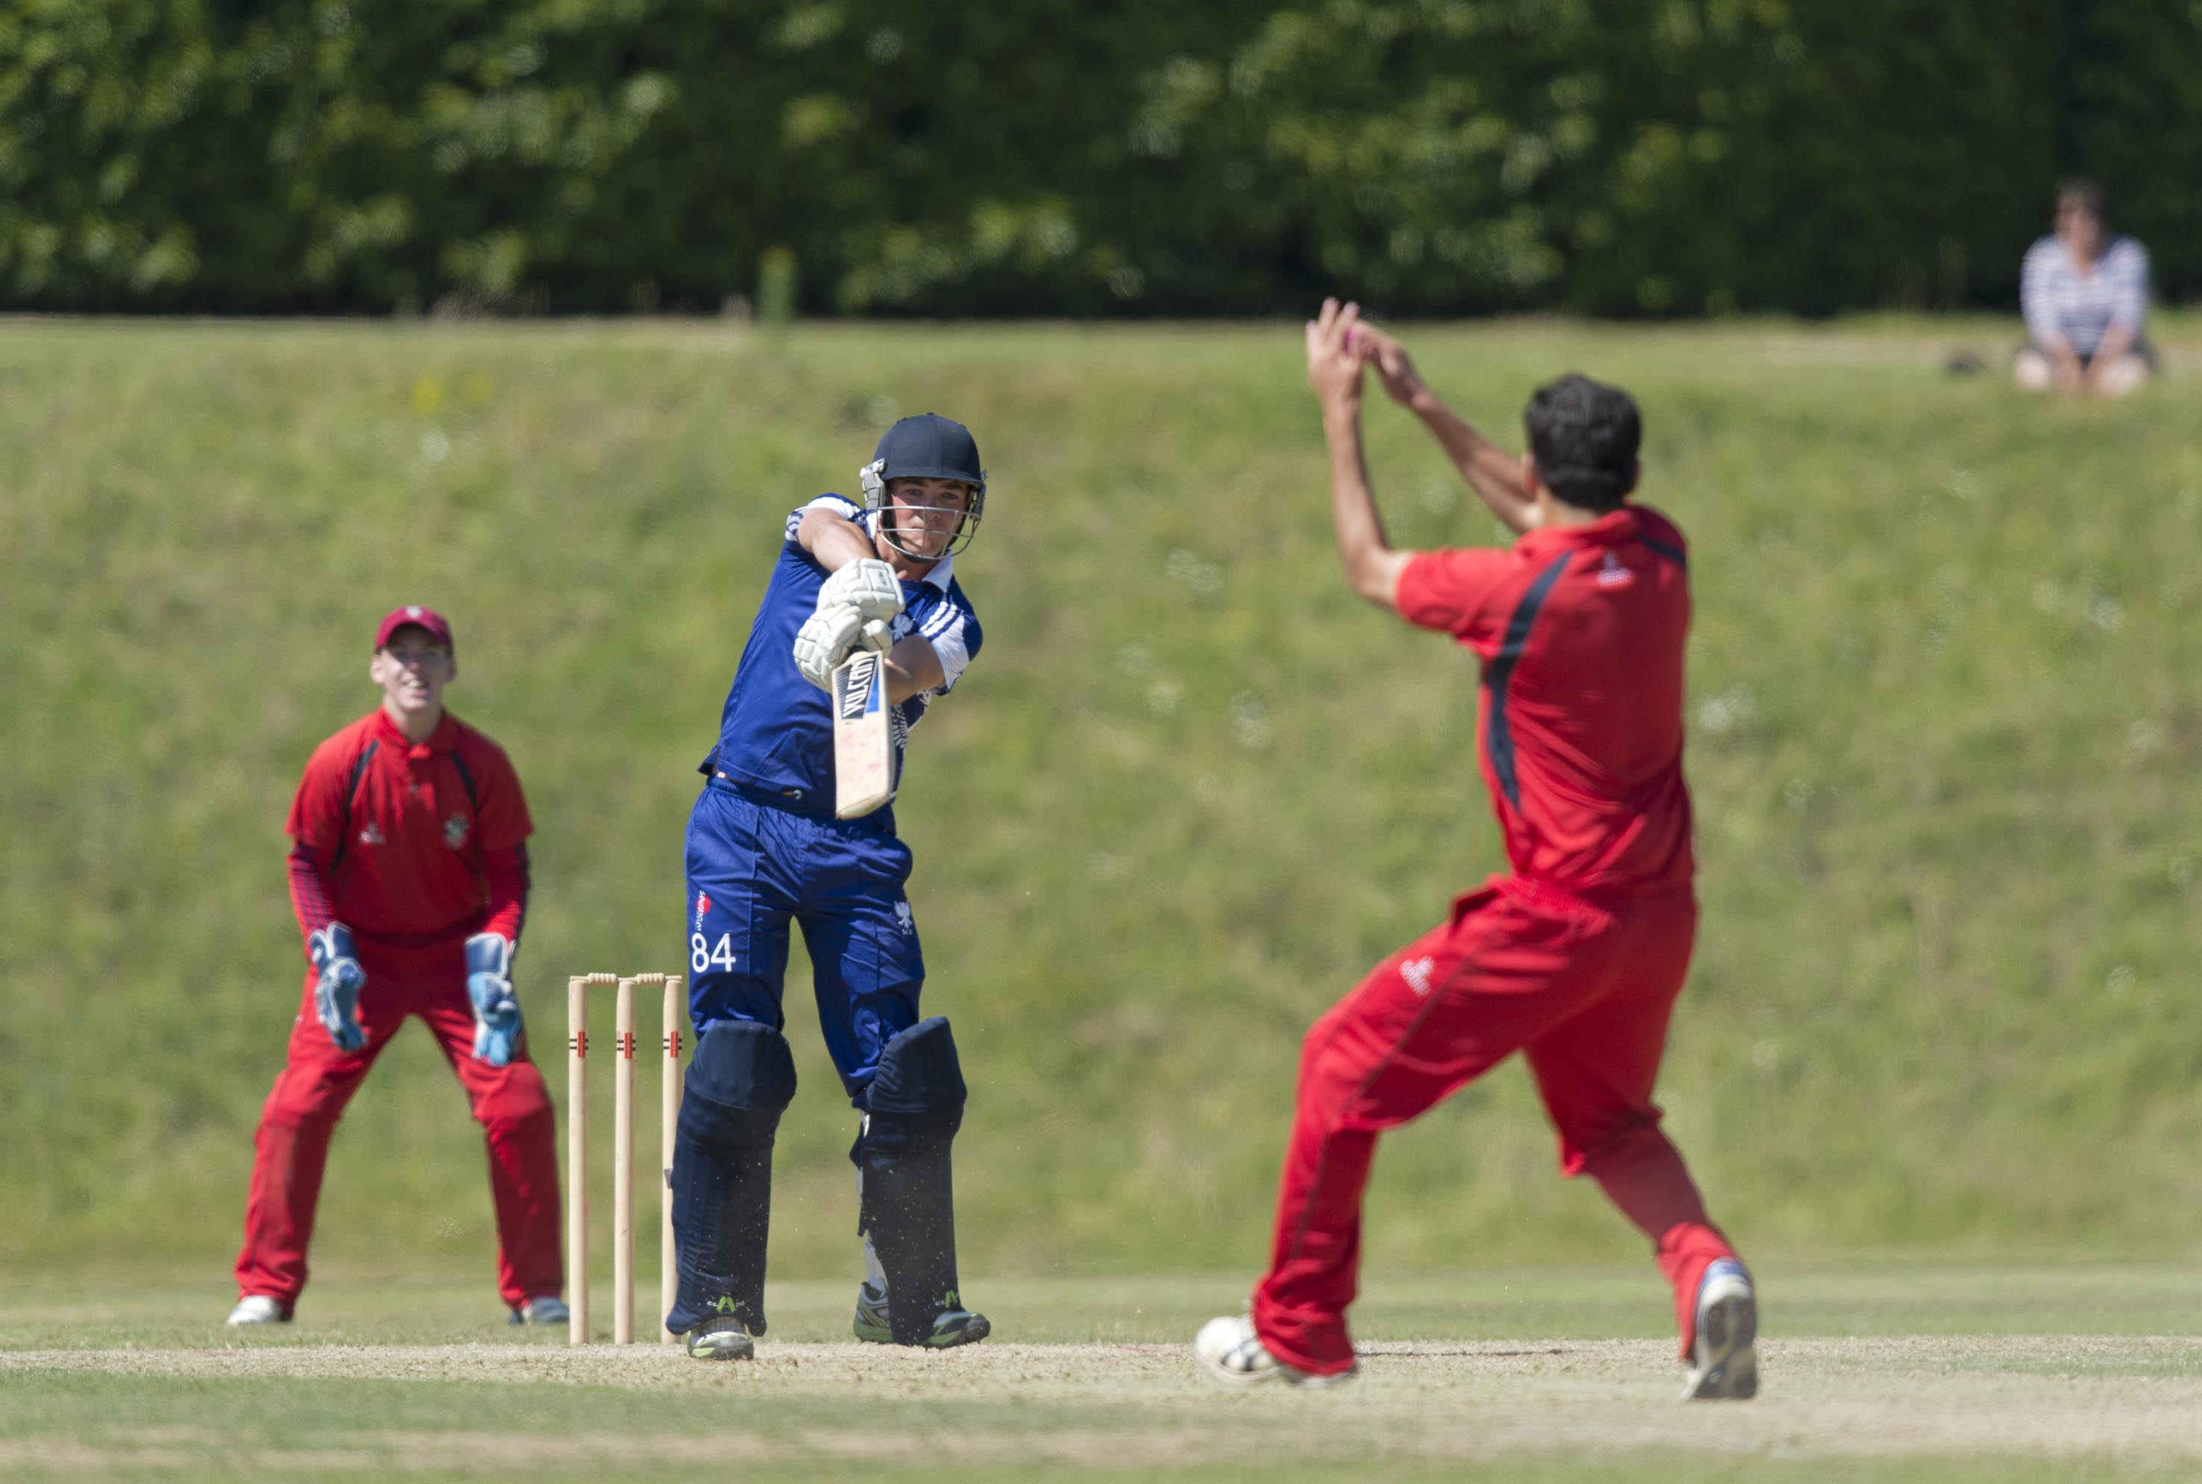
G A Furbank c & b A H Ahmed 51

Slide 17
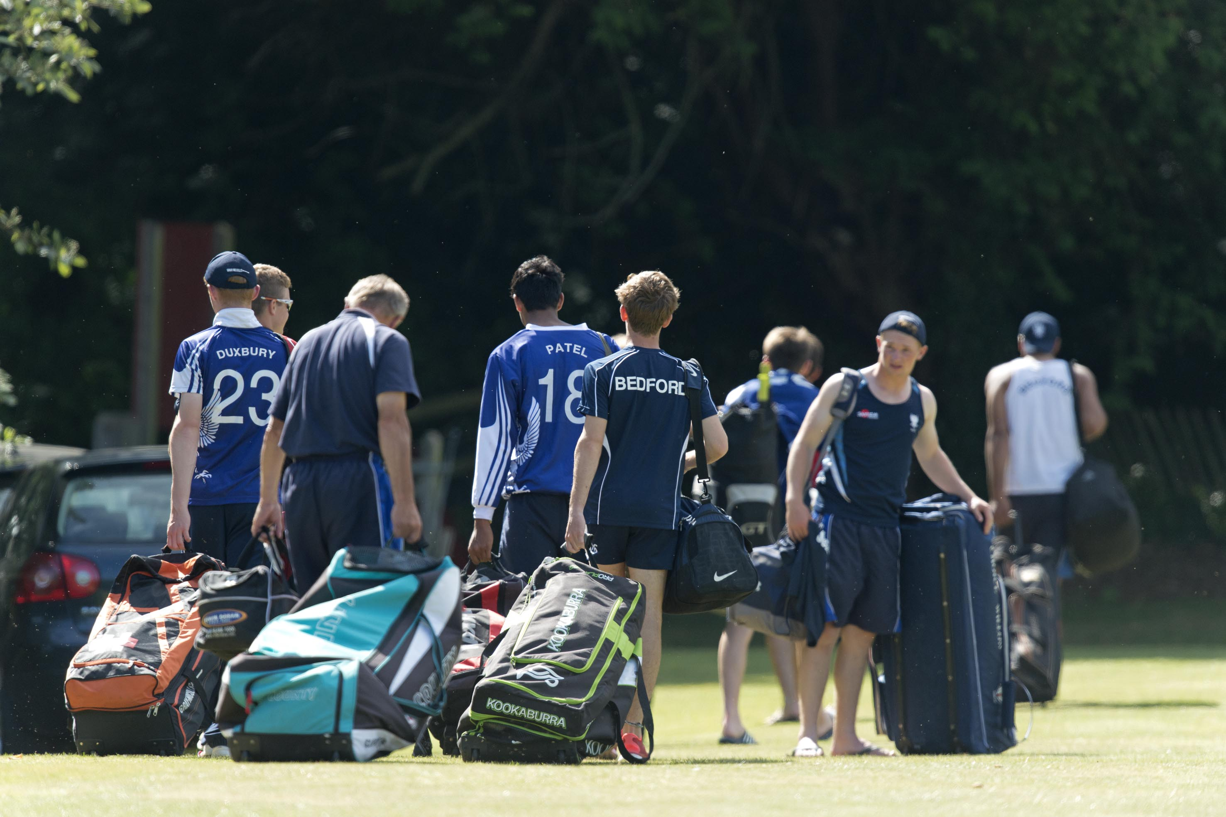
Bedford School leave for home after losing to Millfield

Slide 18
The final
Woodhouse Grove in mauve
Millfield in red

Slide 19
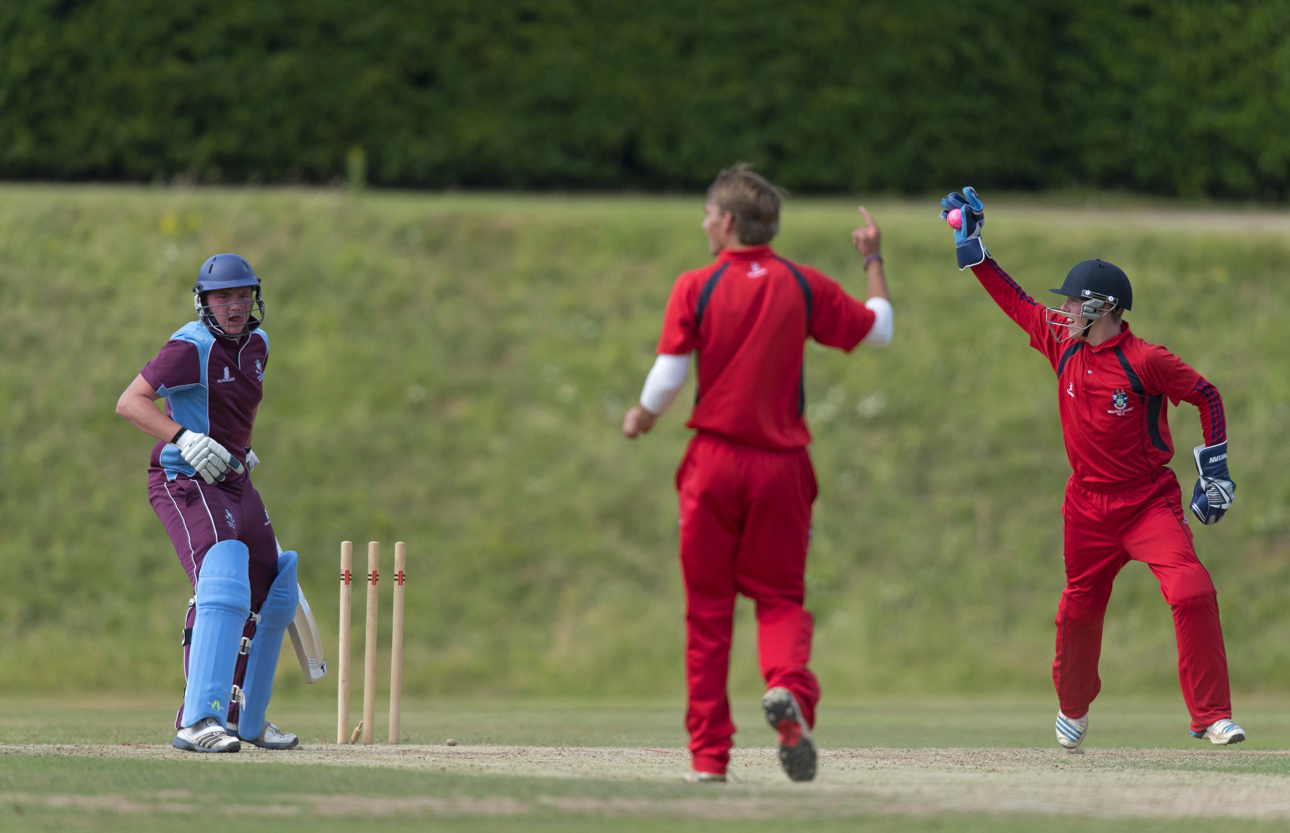
P R Dixon st T J Moores b J O Symes 54

Slide 20
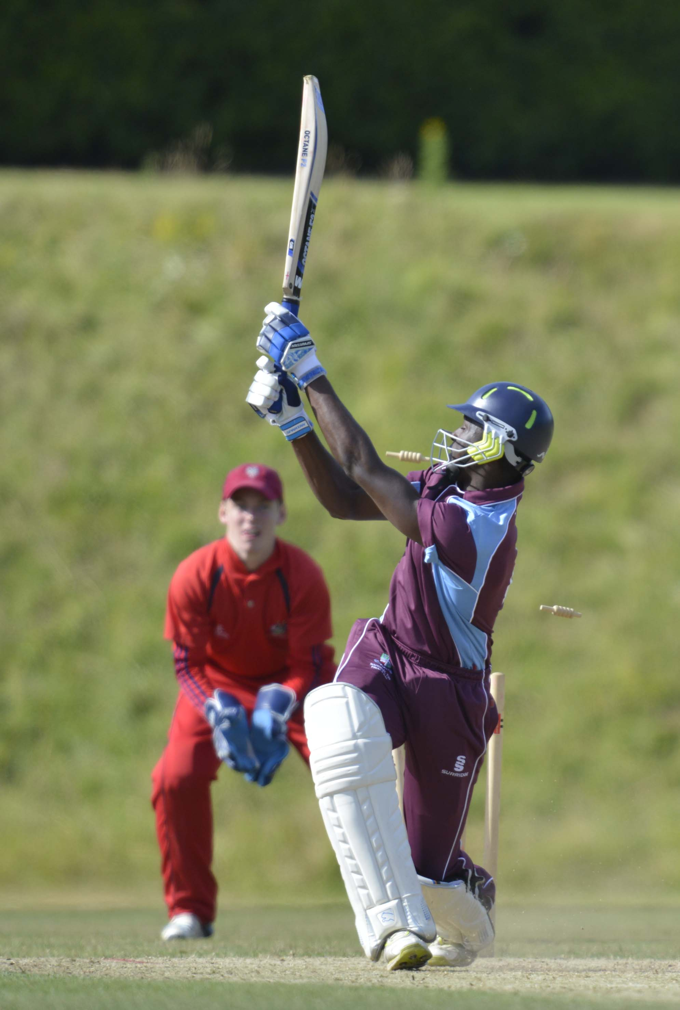
L M Edward is bowled by A N Ahmad

Slide 21
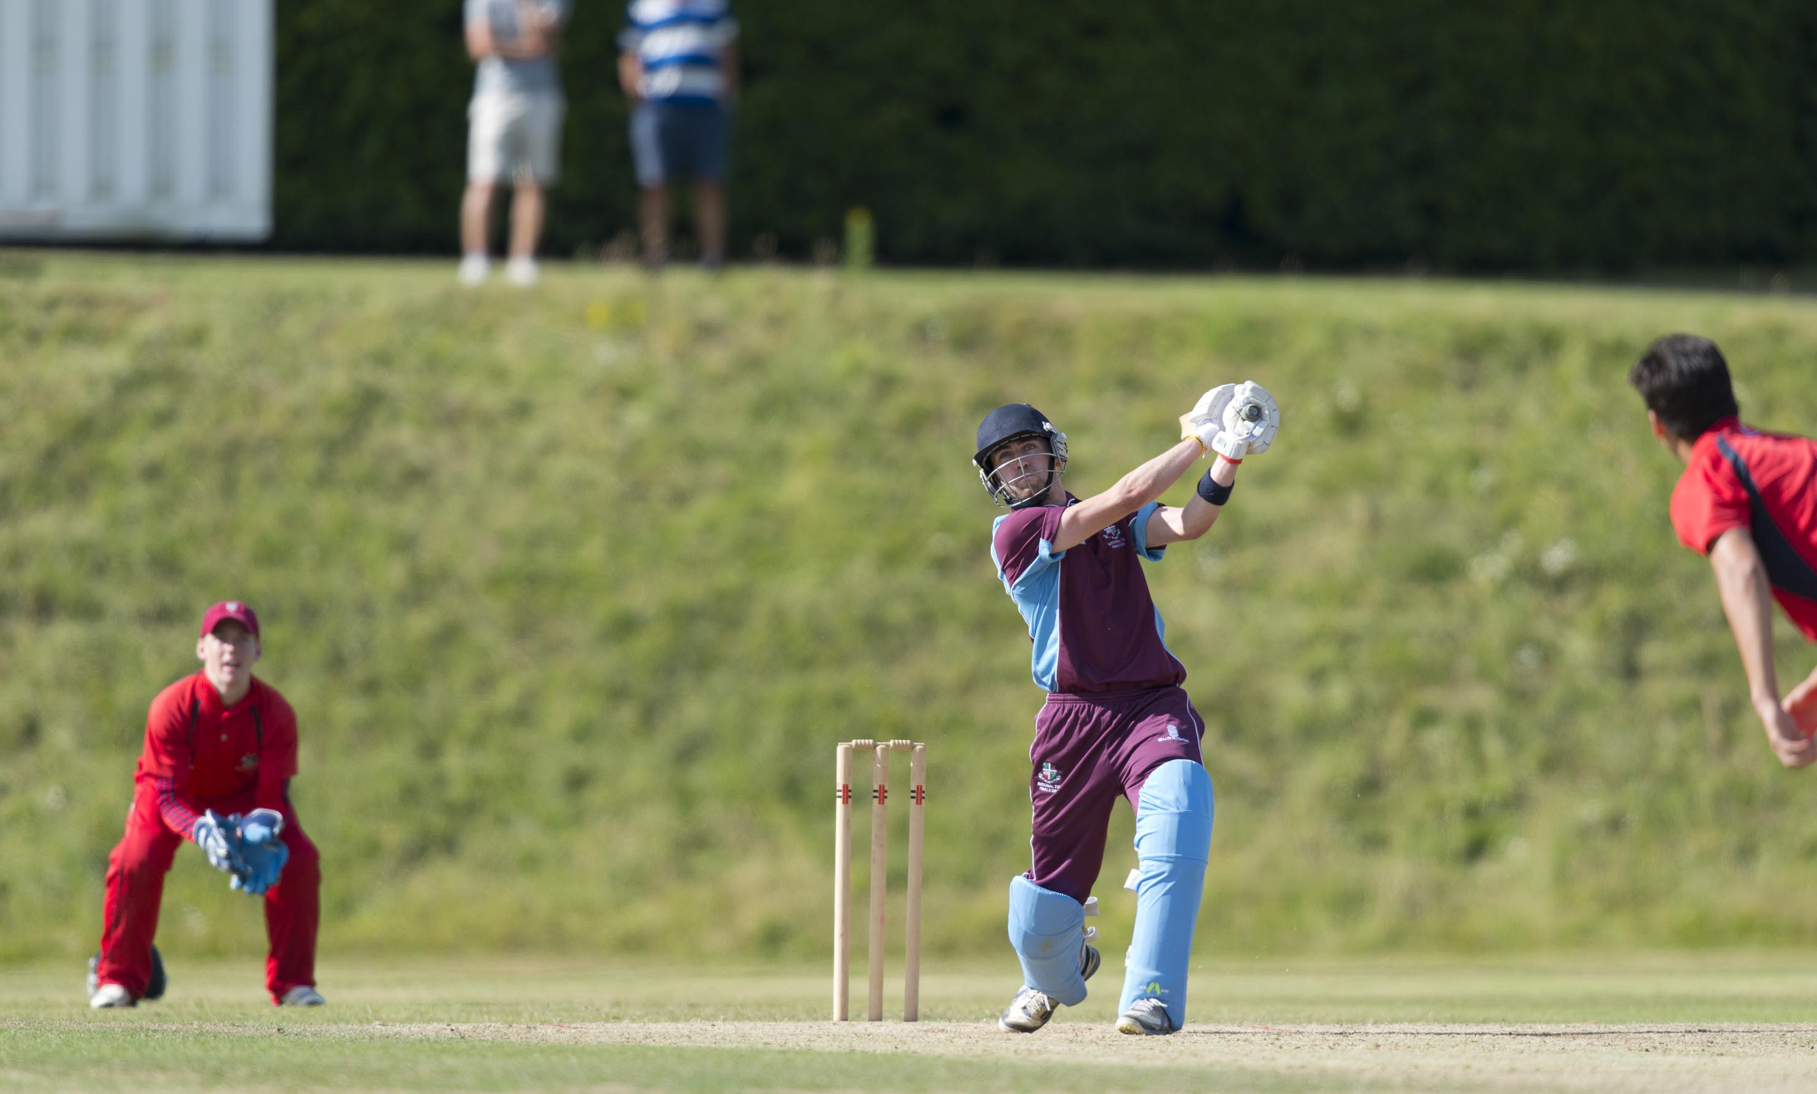
D E Budge hits a six during his innings of 81

Slide 22
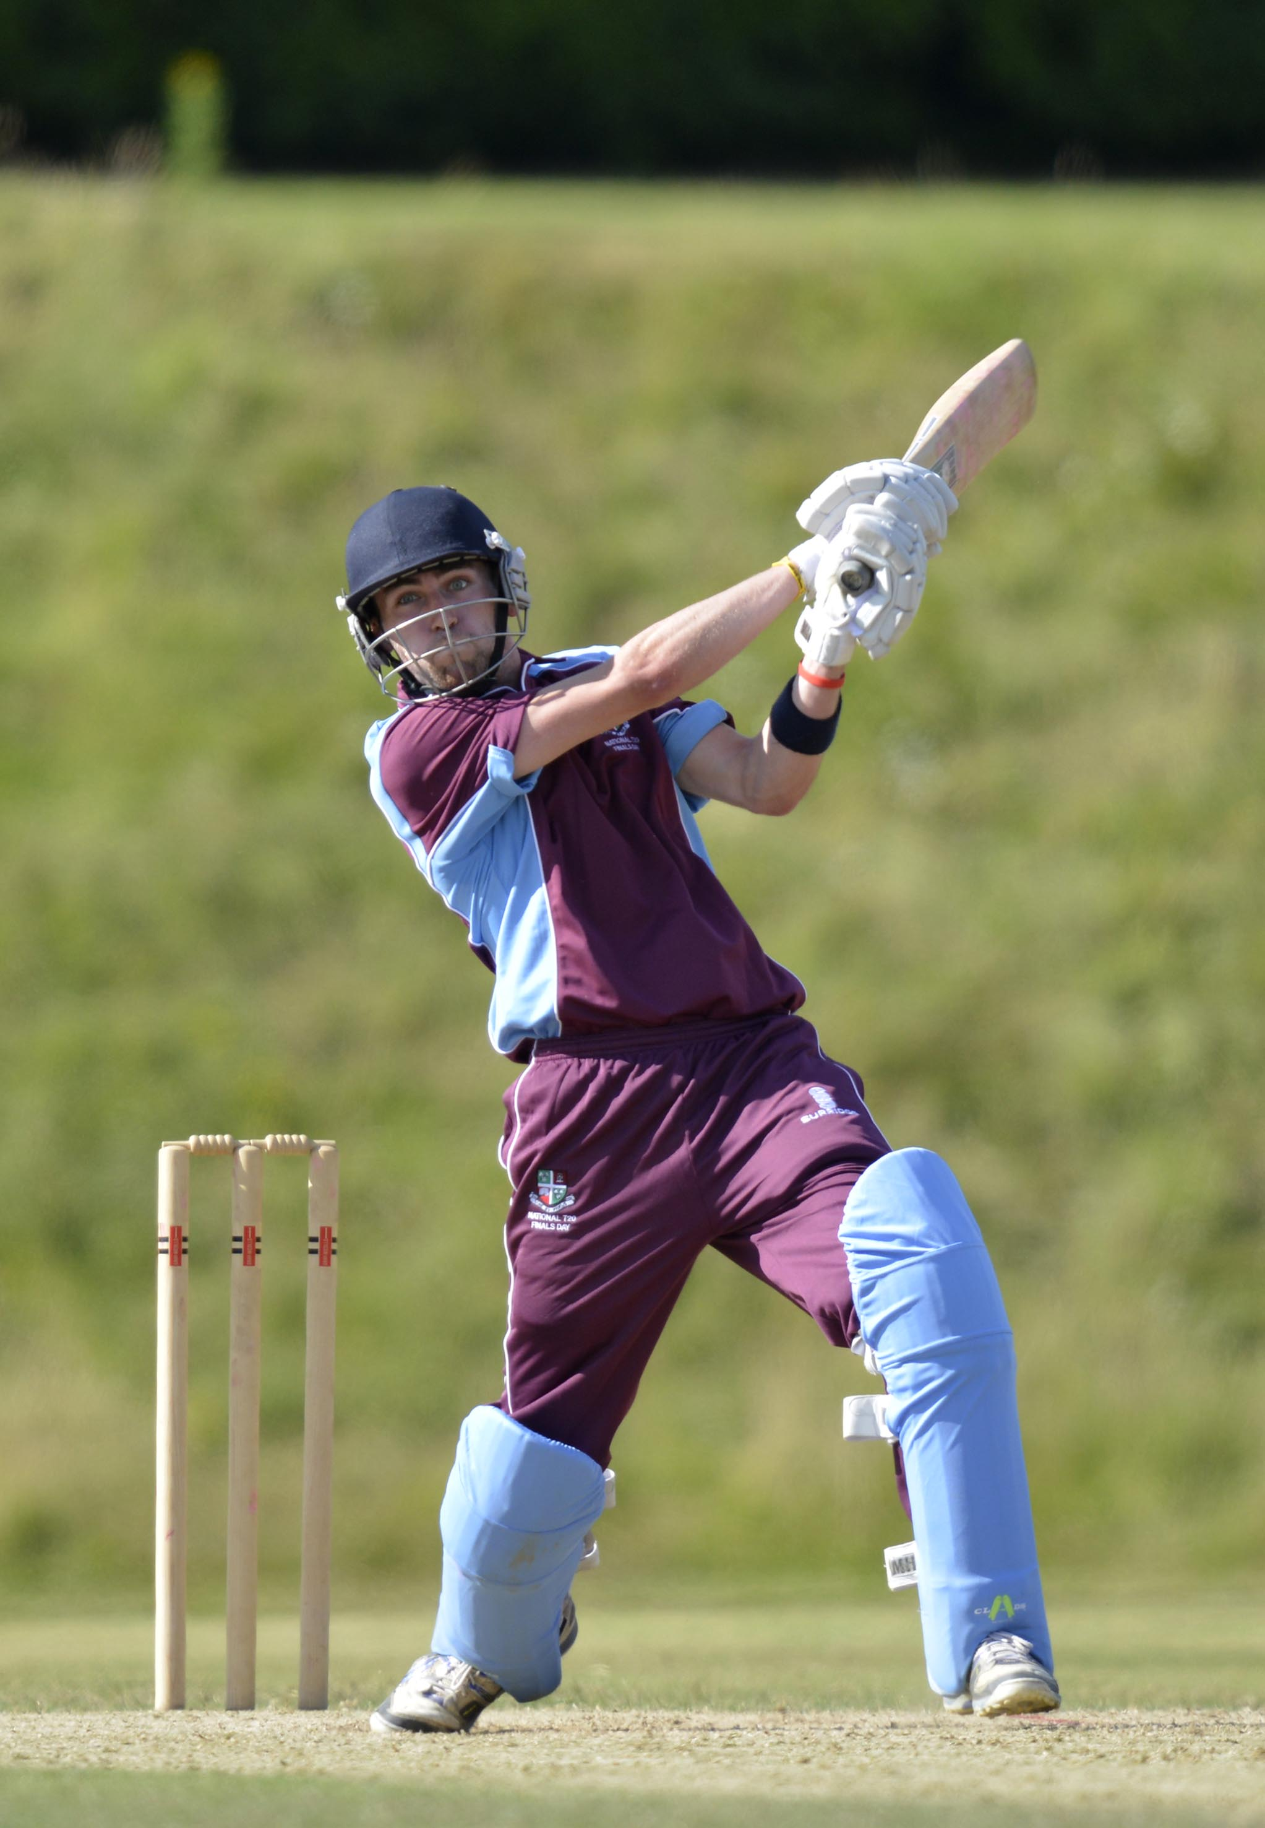
D E Budge batting during his 81

Slide 23
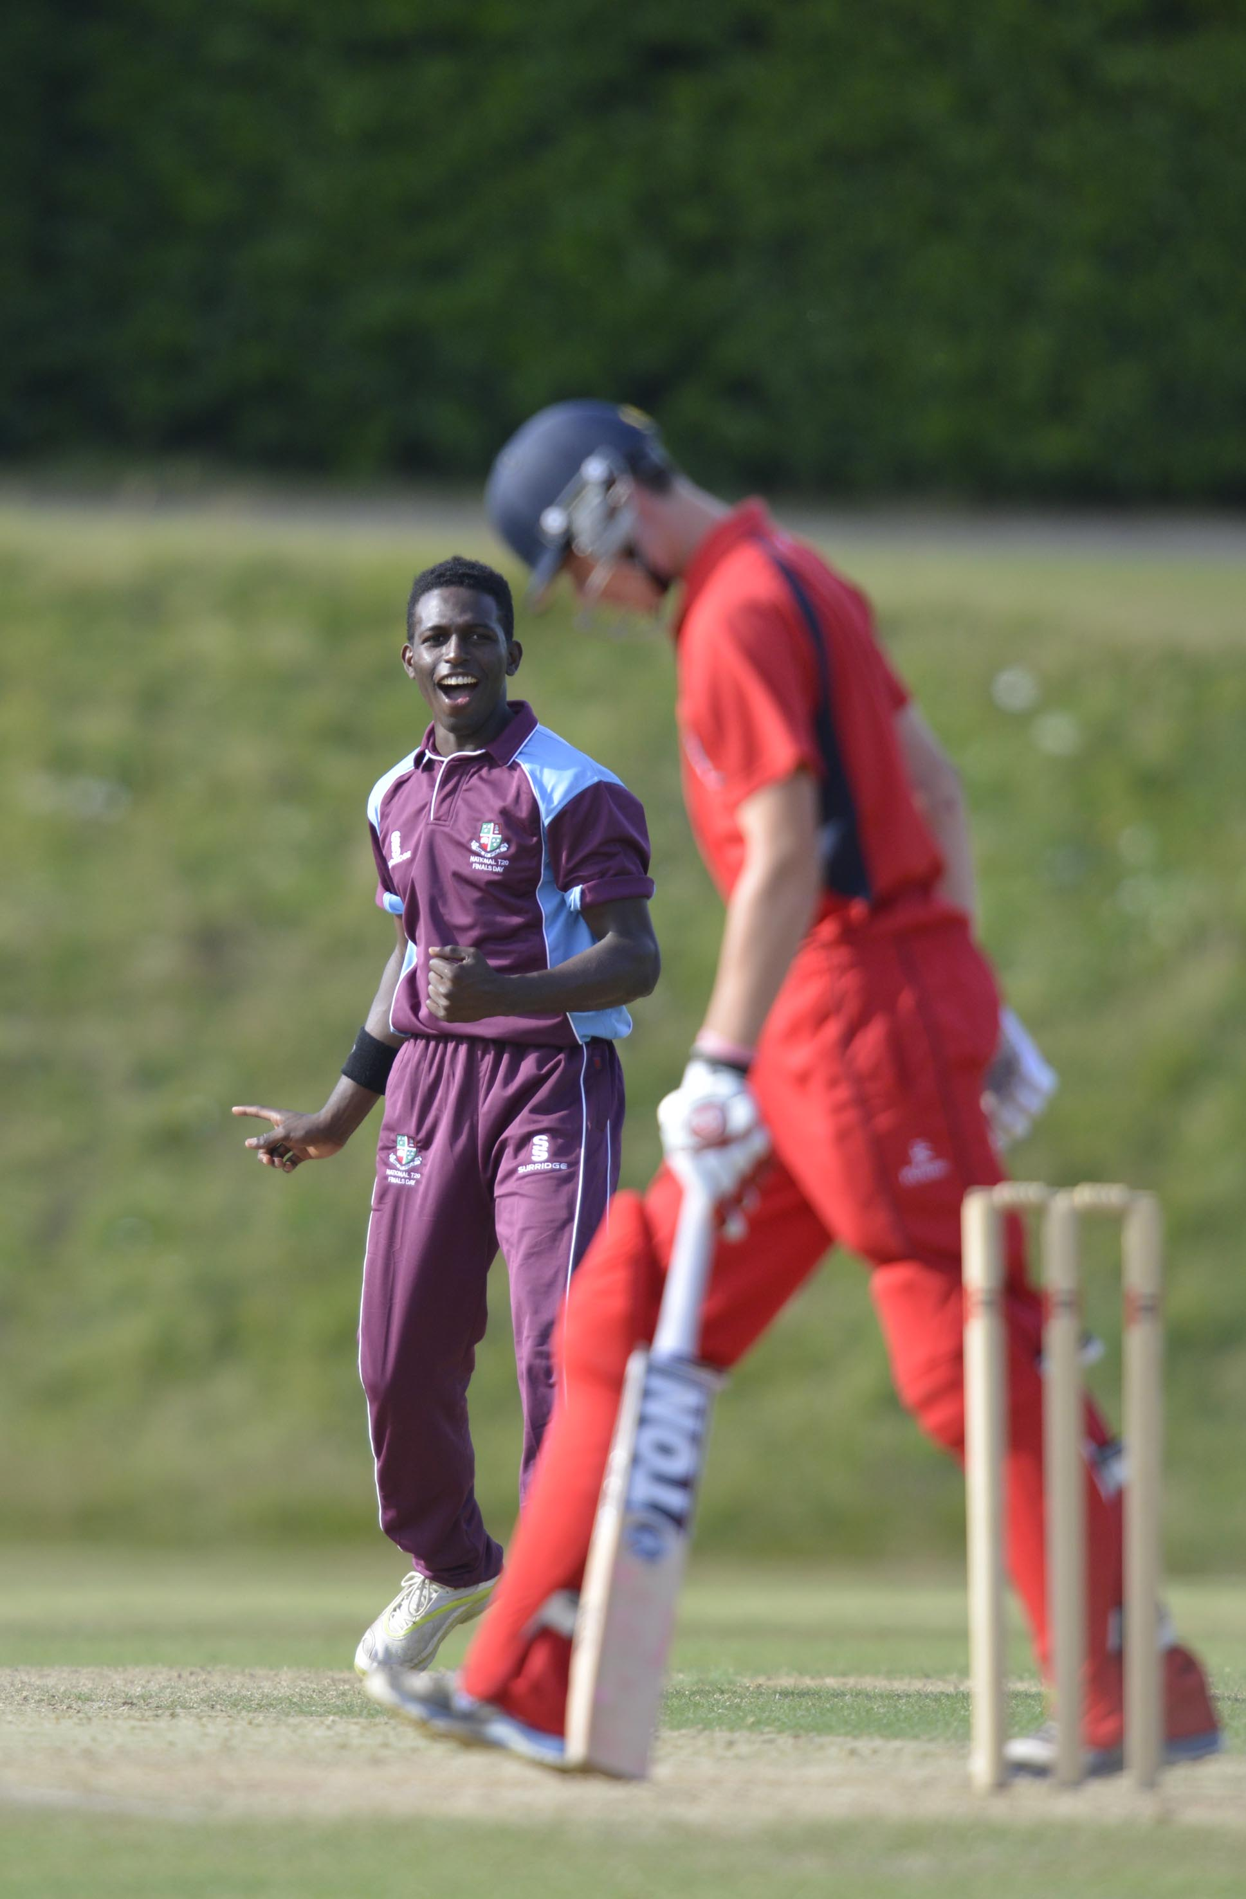
G T Hankins lbw L M Edward 8

Slide 24
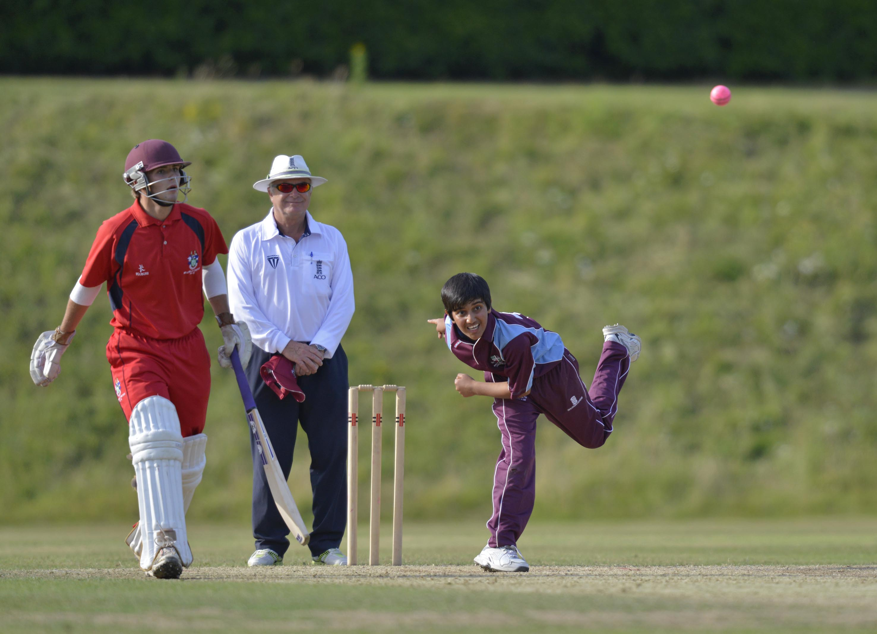
A Ahmed bowling

Slide 25
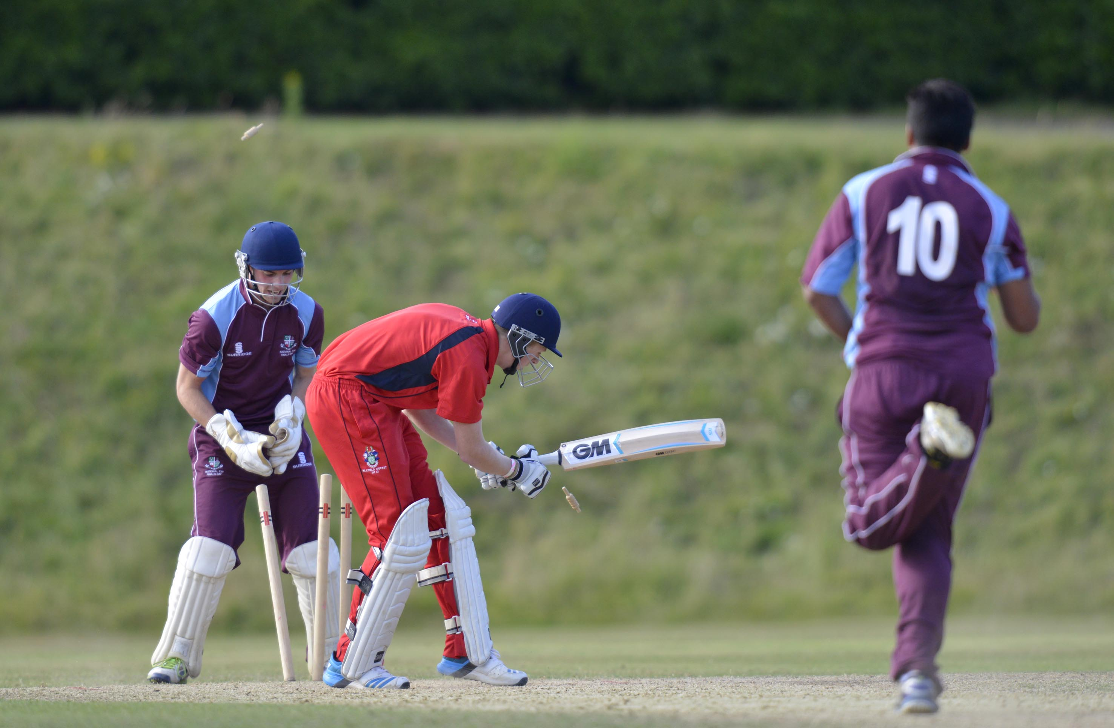
B D Fullard is bowled by J Malik for 2

Slide 26
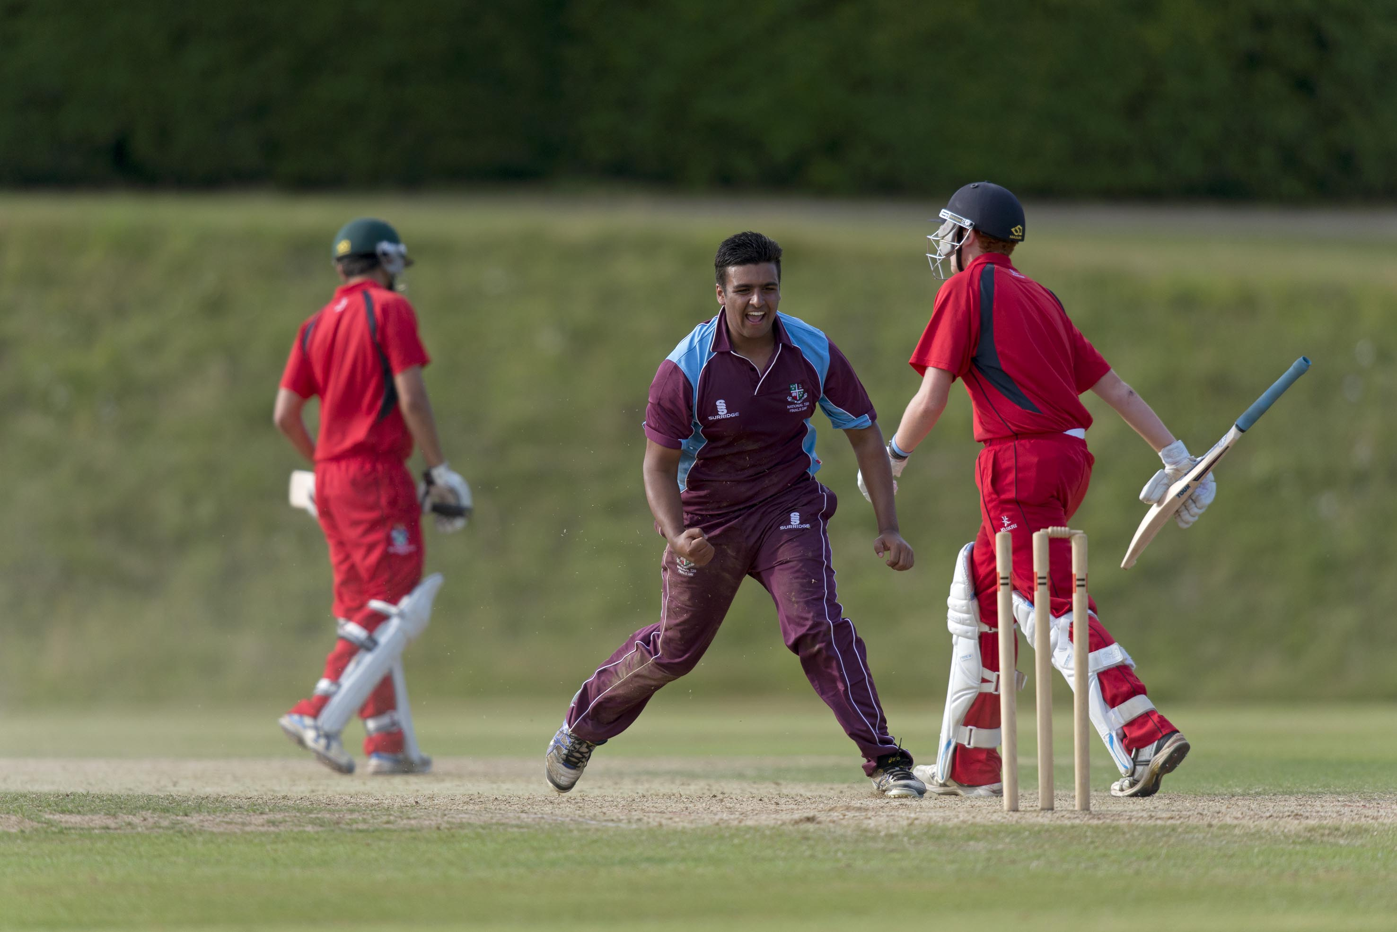
The Final, Woodhouse Grove v Millfield. J Malik after running out M R Phillips

Slide 27
The presentation by Johnny Barclay
former Captain of Sussex and President of MCC
2014 winners
Woodhouse Grove

Slide 28
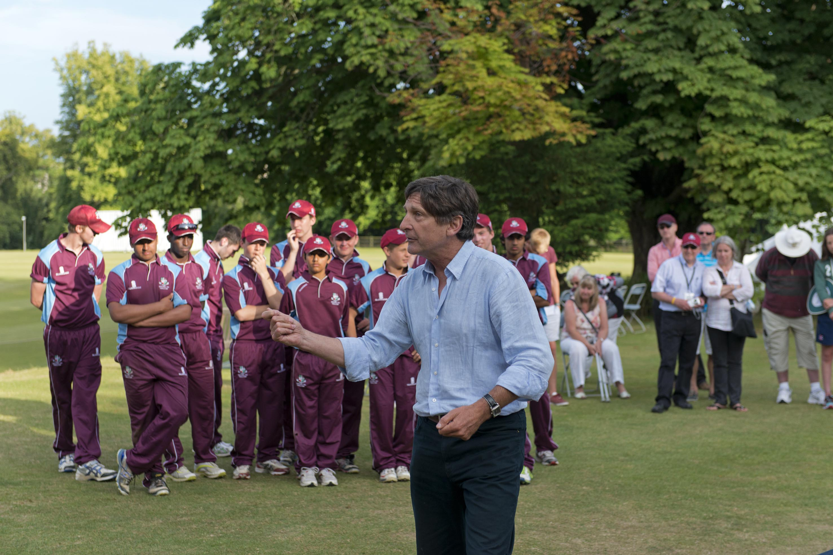
The Final, Woodhouse Grove v MillfieldJohn Barclay talking to the teams at the end of the final, Woodhouse Grove (the winners) are in the background

Slide 29
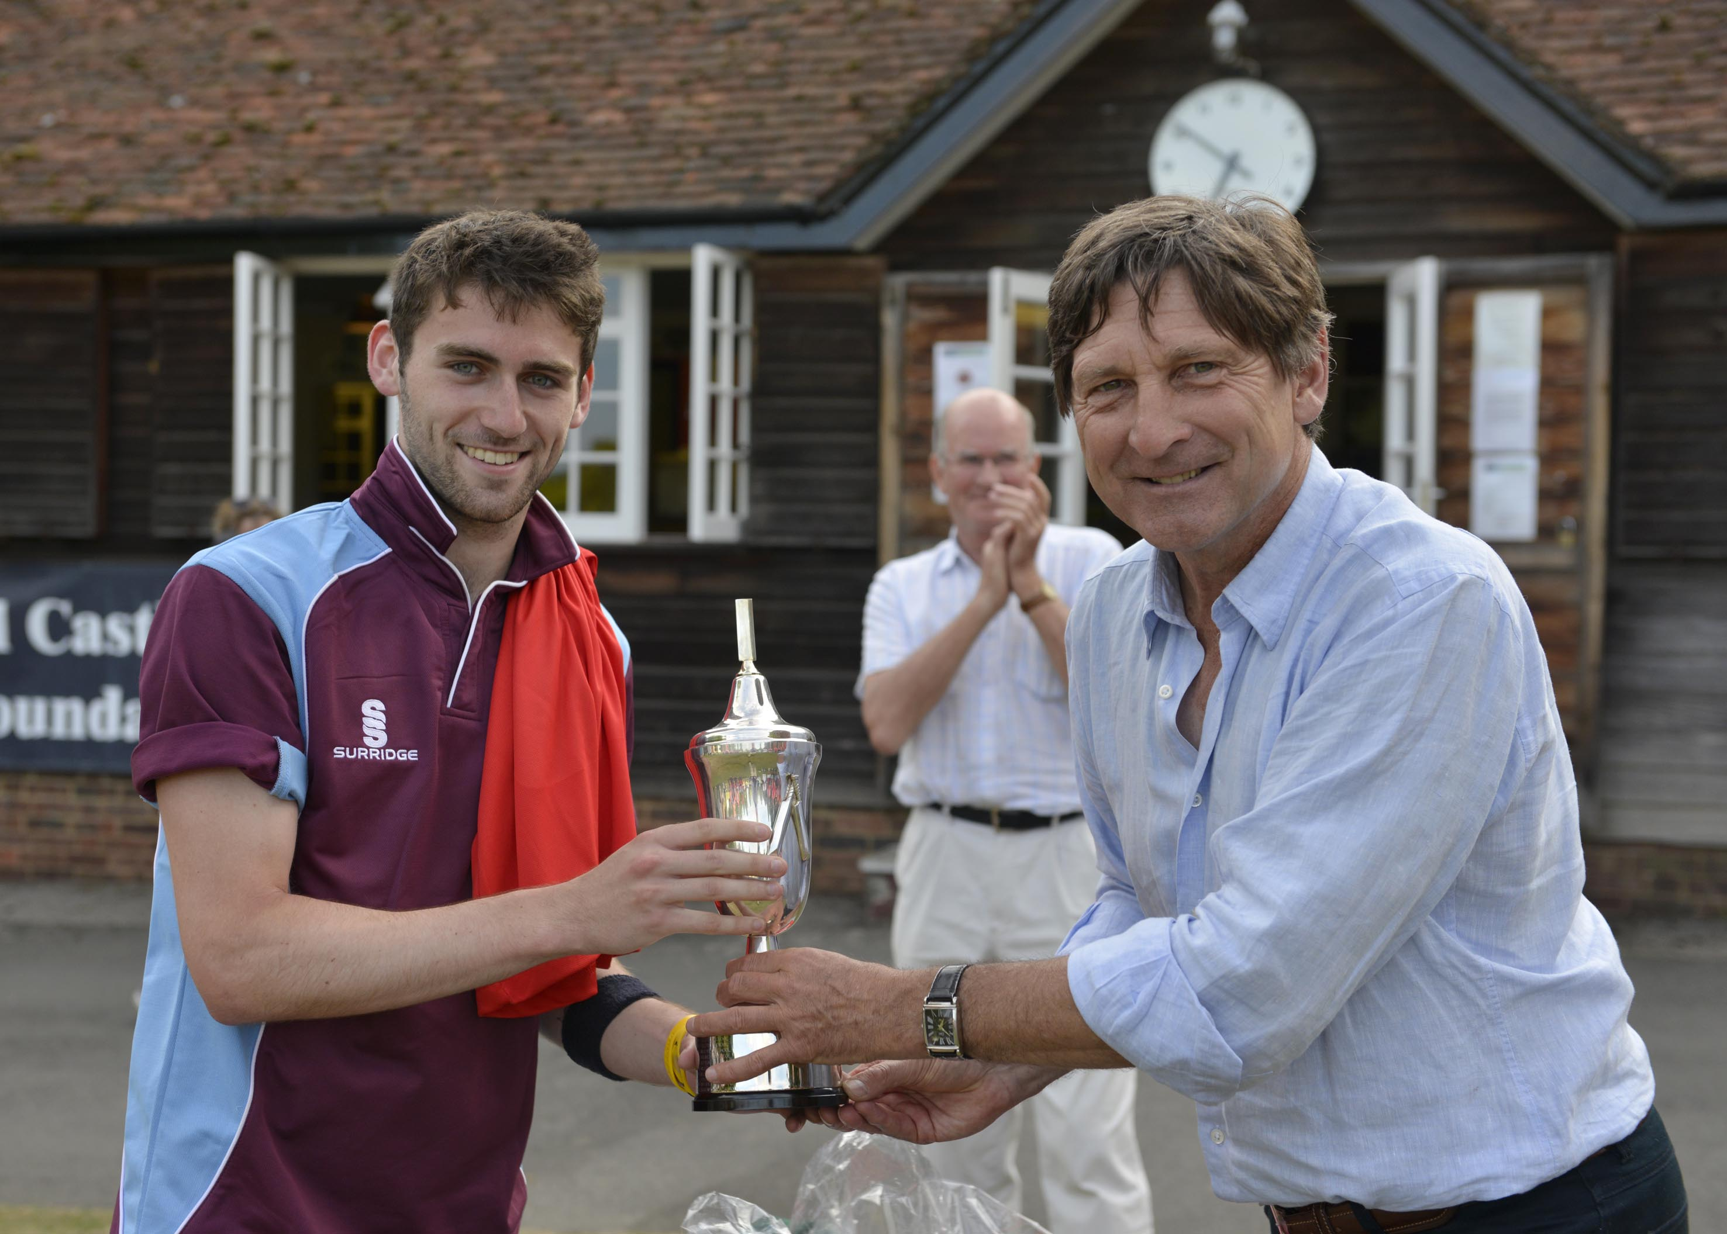
D E Budge (Woodhouse Grove) receives the trophy from John Barclay

Slide 30
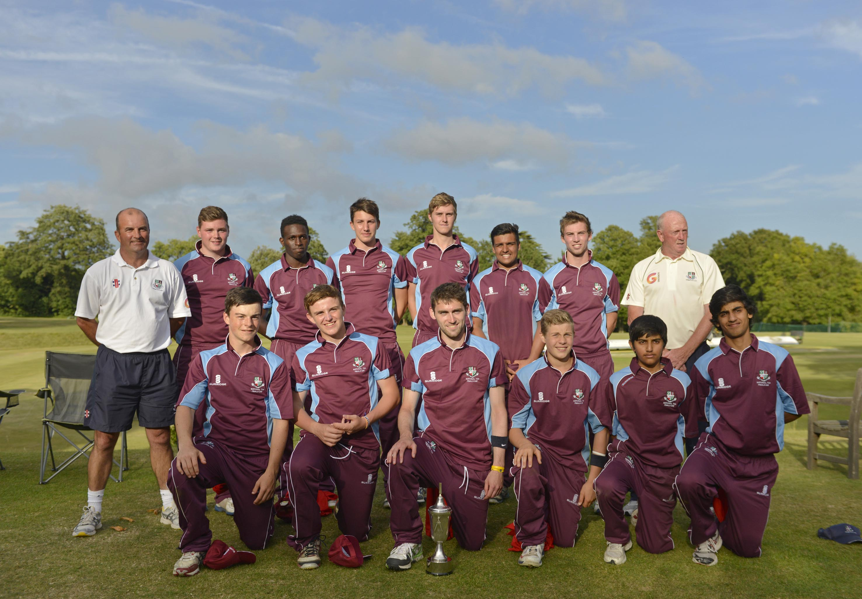
The winners Woodhouse Grove, National Schools Twenty20 Competition 2014

Slide 31
Photographs
by
Patrick Eagar
© No images may be reproduced without permission

Slide 32
National Schools Twenty20 competition
Finals day July 2014
Arundel Castle

